Slide 1
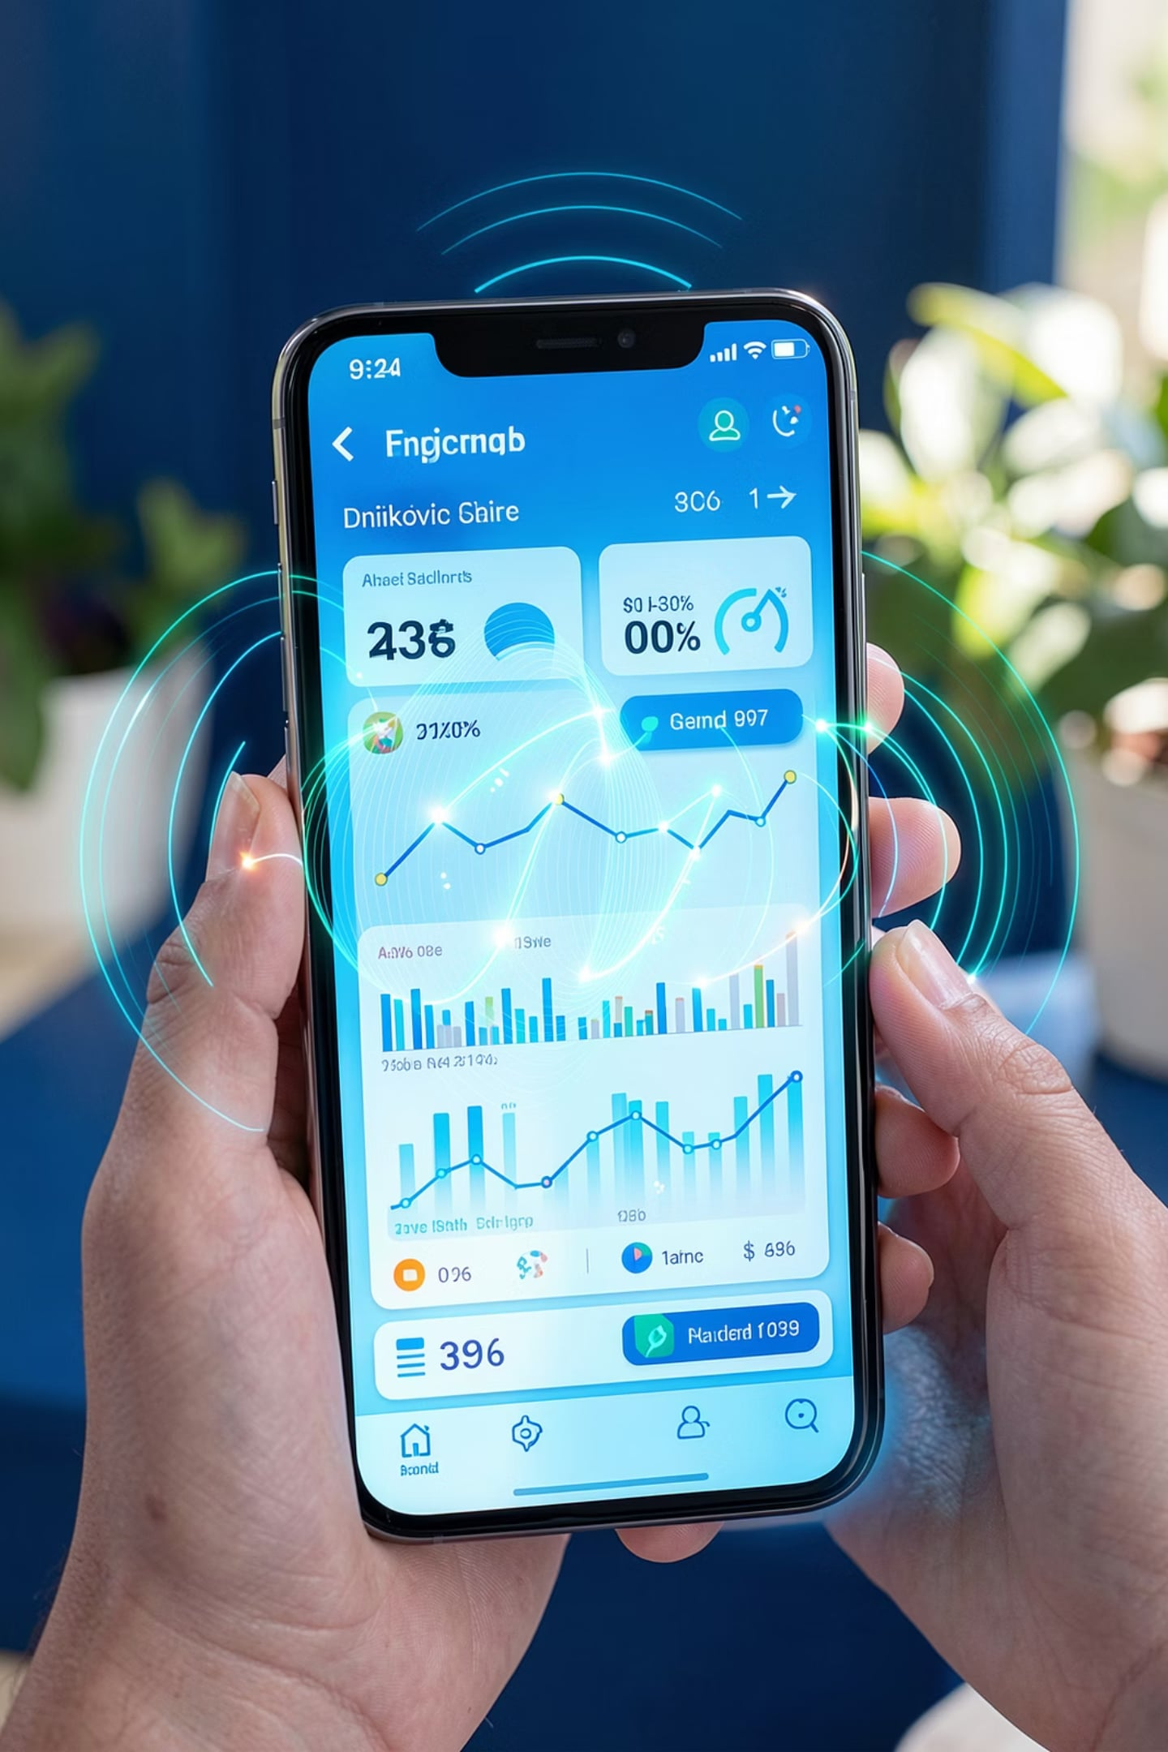
NetPulse Crowdsense
Community-Powered Network Intelligence
Real-time crowdsourced telecom analytics for smarter network optimization.

Slide 2




The Problem
Expensive Drive Tests
Limited Coverage
Costly manual assessments performed only a few times per year
Small geographic reach with poor visibility into customer experience
Infrequent Assessments
Slow detection of coverage problems and network faults
What if every smartphone became a network sensor?

Slide 3







Our Solution
NetPulse Crowdsense transforms ordinary smartphones into passive network monitoring sensors — delivering continuous, real-time intelligence to telecom operators.
Smartphone Data
Passive Collection
Cloud Analytics
Coverage Heatmaps
From passive smartphone data collection to actionable network insights — all automated and real-time.
Signal Monitoring
GPS Mapping
Offline Sync
Speed Testing
Issue Reporting
Interactive Dashboard

Slide 4
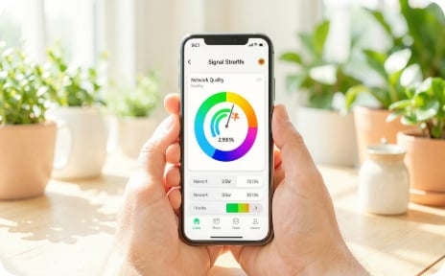

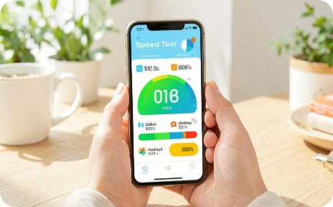
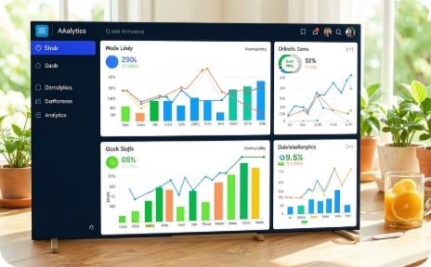
Product Experience
A seamless experience from mobile app to web dashboard — designed for operators and end users alike.
Live Signal Quality
Coverage Maps
Speed Testing
Analytics Dashboard
Real-time signal and quality metrics on every user's device
Interactive heatmaps revealing coverage gaps across regions
Automated and on-demand speed tests from real user locations
Operator-grade insights, fault alerts, and infrastructure reports

Slide 5






Why It Matters
Reduce Costs
Nationwide Monitoring
Eliminate expensive manual drive tests
Continuous coverage across entire countries
Faster Fault Detection
Better CX
Identify and resolve issues in real-time
Improve customer satisfaction with data-driven decisions
Smart Infrastructure
Multi-Operator
Data-driven planning for network deployment
Support multiple telecom operators simultaneously

Slide 6
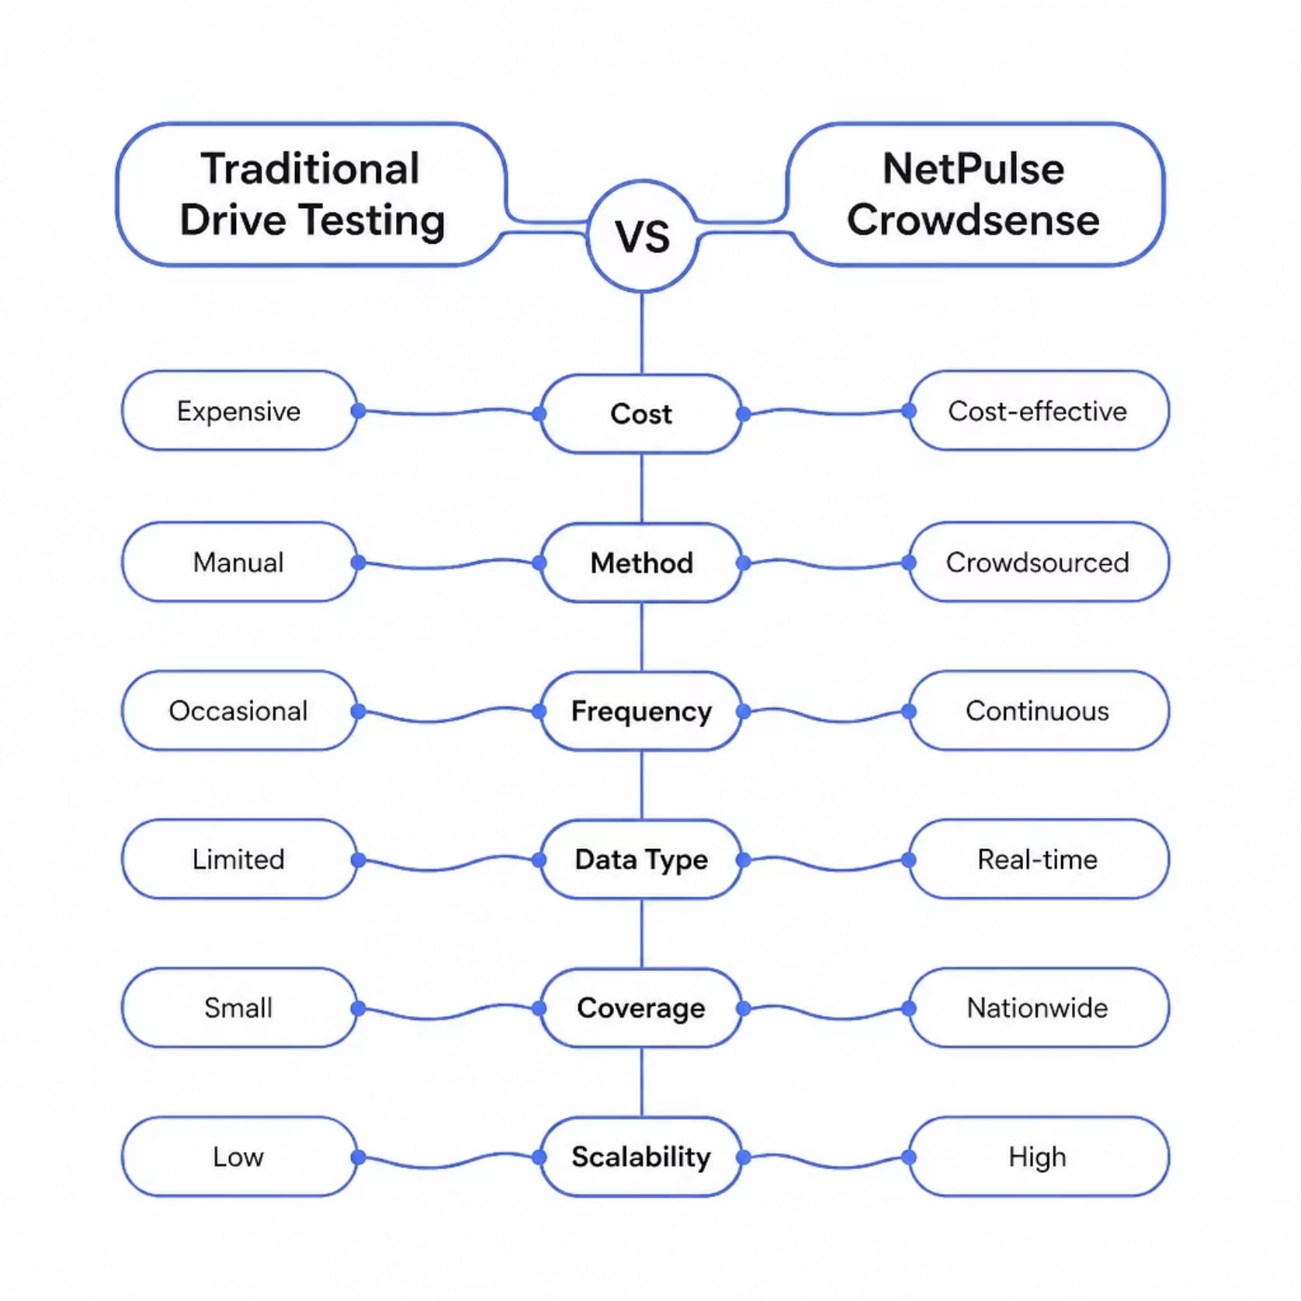
Competitive Advantage
Traditional drive testing is costly, manual, and infrequent. NetPulse Crowdsense replaces it with continuous, automated, crowdsourced intelligence at a fraction of the cost.

Slide 7





Market Opportunity
A vast and underserved market across Africa — with expansion potential into multiple African markets.
Telecom Operators
Regulators & ICT Agencies
Internet Service Providers
Primary customers seeking continuous network intelligence
Government bodies monitoring national coverage standards
ISPs expanding broadband and mobile connectivity
Smart City Projects
Research Institutions
Urban initiatives requiring real-time connectivity data
Academic and policy research on telecom infrastructure

Slide 8
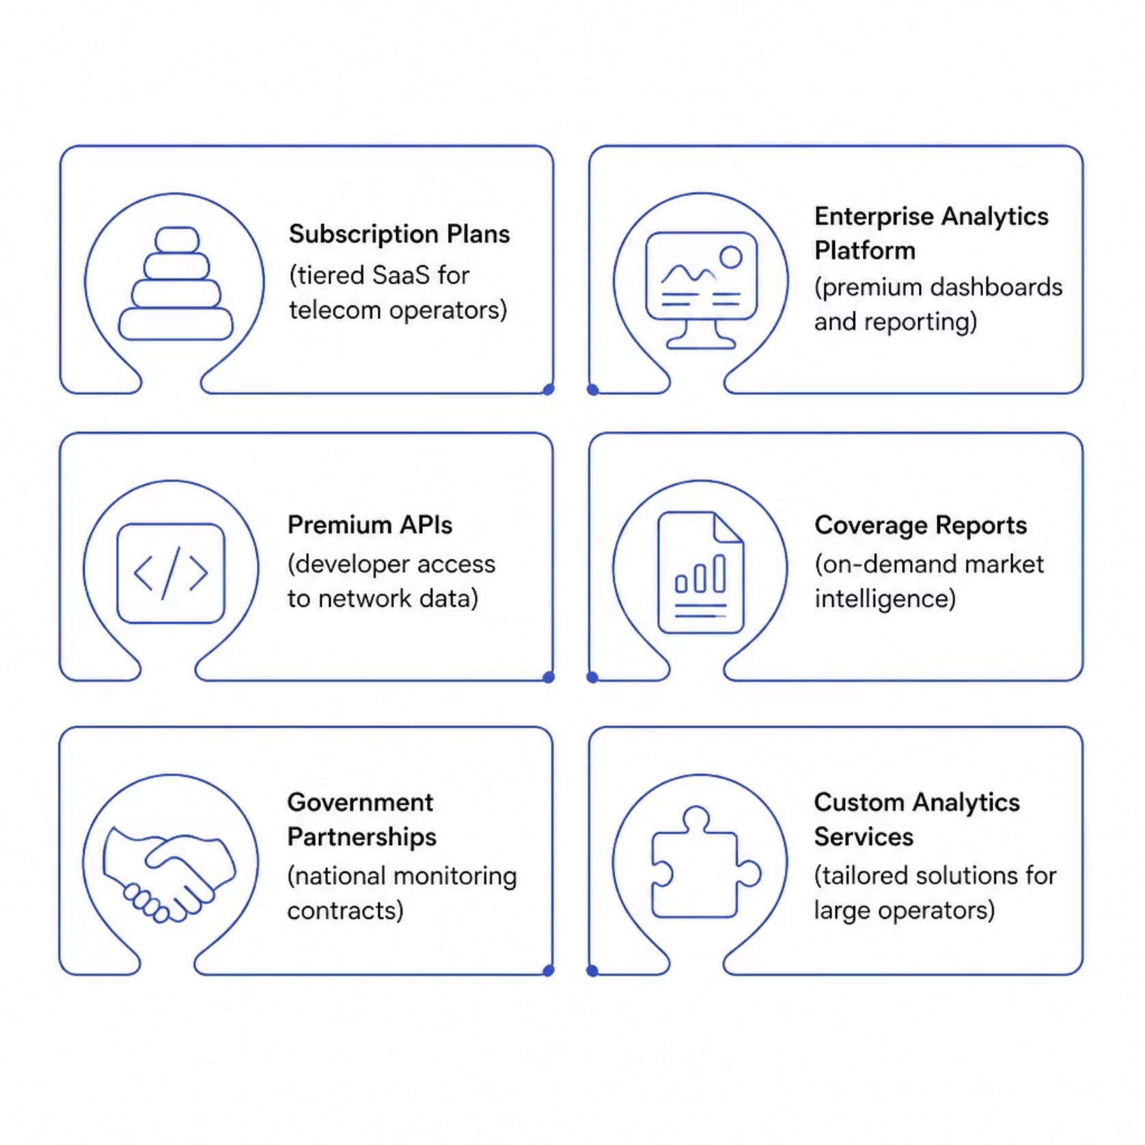

Business Model
NetPulse Crowdsense monetizes through a diversified SaaS model — combining recurring subscriptions with high-value enterprise services and government partnerships.
Recurring Revenue
High-Margin Services
Strategic Partnerships
Subscription plans and enterprise platform licenses
Premium APIs, custom analytics, and coverage reports
Government and regulator contracts for national monitoring

Slide 9
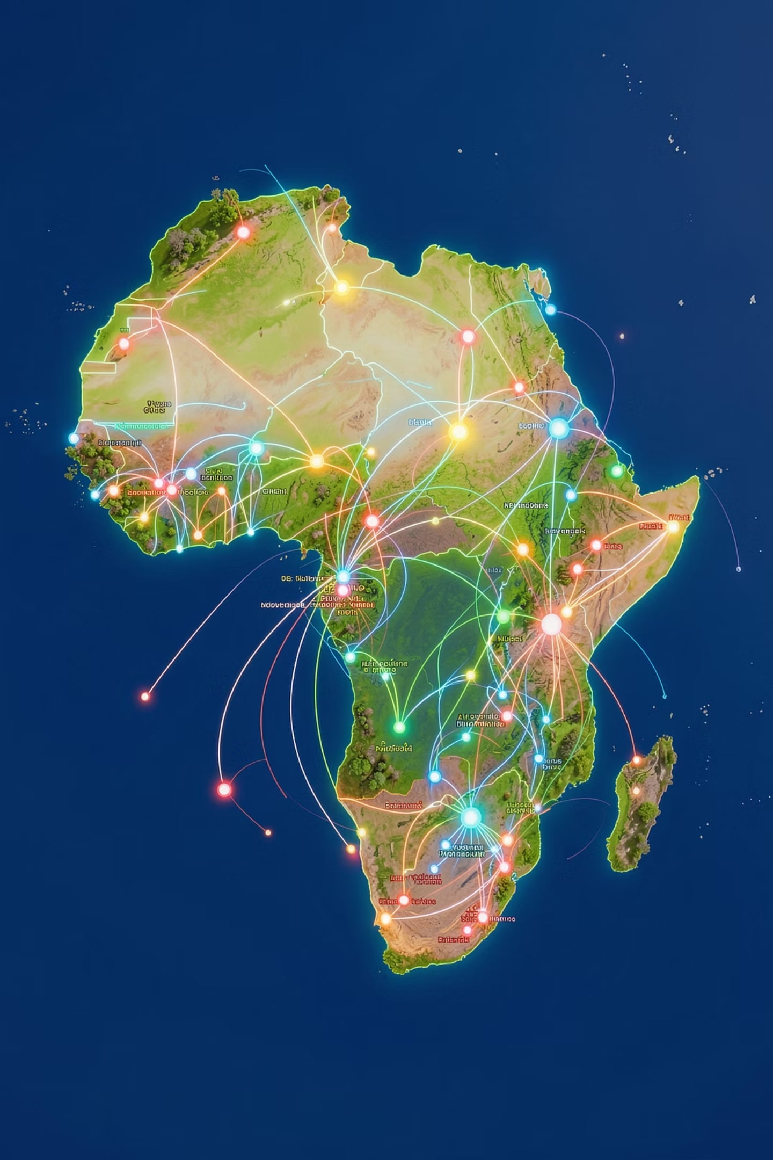
Future Vision
1
Phase 1 — Cameroon
Launch and validate the platform with initial operator partnerships
2
Phase 2 — Central Africa
Expand to neighboring markets and scale user base
3
Phase 3 — Africa-Wide
Become the continent's leading crowdsourced telecom intelligence platform
AI-Powered Future Features
Coverage Prediction
Outage Forecasting
5G Optimization
Infrastructure Recommendations

Slide 10

Together, we can build Africa's largest crowdsourced mobile network intelligence platform.
NetPulse Crowdsense
Community-Powered Network Intelligence
Thank You
Let's connect and discuss how we can transform network intelligence together.

